Slide 1

Coin Cast
BitCoin Time-Series Forecasting
Presented By,
Team Synergy
Shubham Kothiya
Soumya Bharathi Vetukuri
Rutuja Patil
Mann Nada

Slide 2

Abstract
This project aims to develop a robust and reliable forecasting model to predict Bitcoin prices.
Originated from the idea of creating a solution aligned with a trending and impactful topic.
Aimed to demonstrate various data preprocessing and preparation techniques.
Develop multiple models, compare their performances and evaluate metrics to showcase the best-performing model.
Integrate interactive UI and visualizations to present data insights.

Slide 3

Introduction
Adopted CRISP-DM Methodology.
Models explored include ARIMA, Random Forest, Gradient Boosting and LSTM.
Hyperparameter tuning performed to optimize model performance.
Price Forecasting for the next 60 days.
Evaluation metrics: MSE, RMSE, MAE and R²
Gradio based interactive UI to present data insights.
Hugging Face Deployment of Model.

Slide 4
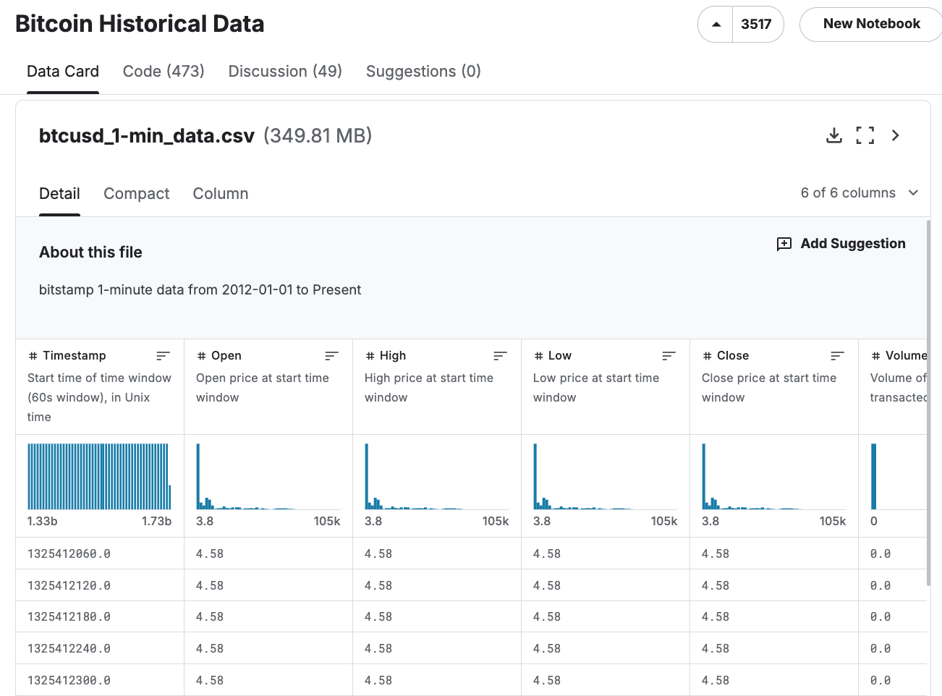
Data and DataSet
Source: Bitcoin Historical Data
Bitcoin exchanges for the time period of Jan 2012 to Present with minute to minute updates of OHLC (Open, High, Low, Close) and Volume in BTC.
Open:Open Price at Start Time Window
High: High Price at Start Time Window
Low: Low Price at Start Time Window
Close: Closing Price at the end of Interval
Timestamp: Time Window
Volume: Volume of BTC transactions.

Slide 5
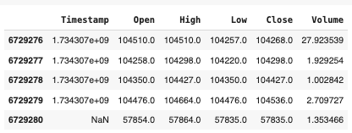
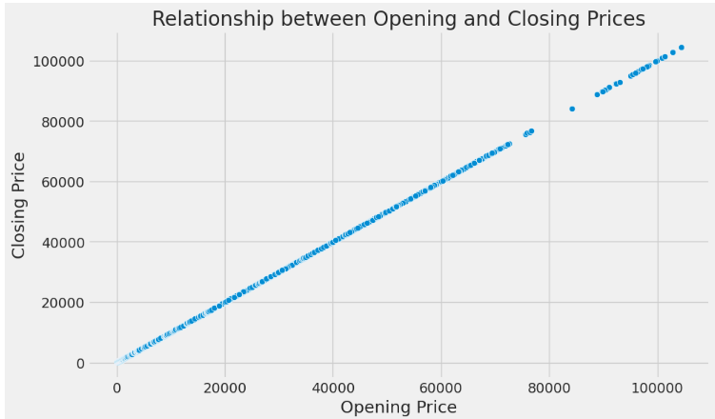
Data Analysis
Explored the historical Bitcoin dataset to gain insights.
Converted timestamps into a readable date format.
Aggregated data to a daily level by calculating the mean values for OHLC prices and Volume.
Conducted Univariate Analysis to identify trends:
Calculated average, minimum and maximum prices.
Checked for outliers using Interquartile Range (IQR).
Visualized the data using line plots to observe price trends over time.

Slide 6

Data Preparation
Prepared the dataset for modeling by cleaning and transforming the data.
Converted timestamps to date format and grouped data by date.
Handled missing values and ensure data consistency.
Normalized the data using MinMaxScaler for deep learning models like LSTM.
Split the dataset into training (75%) and testing (25%) sets to ensure proper model evaluation.
Created a new DataFrame (df_day) containing daily mean values for Open, Close, High, Low prices, and Volume.

Slide 7
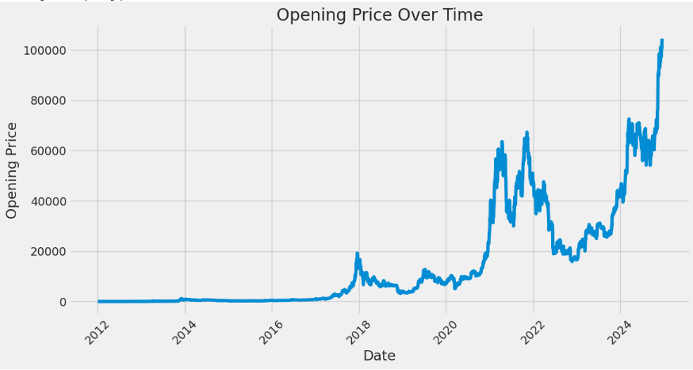

EDA and More..
Critical insights into the historical Bitcoin dataset
Univariate Analysis and Visualizations.
Bivariate Analysis and Visualizations.
Exploratory Data Analysis (EDA) provided helped understand trends, patterns and anomalies in the data.
Performed, visualized: Price Trends over Time, Statistical Insights, Outlier Detection,
Volume Analysis, Correlation Analysis.
Data Normalization and Preparation for modeling.

Slide 8
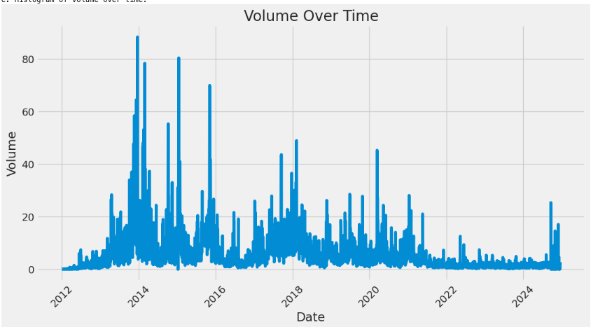
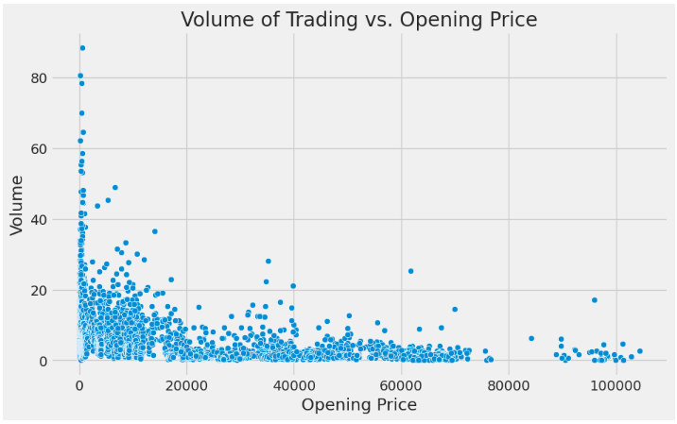
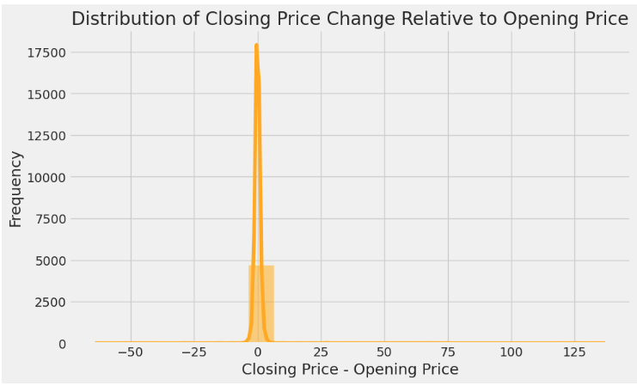
EDA and Visualizations

Slide 9
Modeling
ARIMA
Random Forest
LSTM
XGBoost
Auto-Regressive Integrated Moving Average
Best suited for Linear Trends
Parameters tuned to optimize performance.
Captures Non-Linear
relationships
Handles Large Datasets Efficiently
Less Ideal for Large Scale Time Series Forecasting
Gradient Boosting
Powerful Ensemble Model that boosts weak learners
Fine-tuned learning rate and tree parameters to prevent overfitting.
Long Short Term Memory
Deep Learning Model for Sequential Data.
Multiple LSTM layers - Improve Performance.

Slide 10
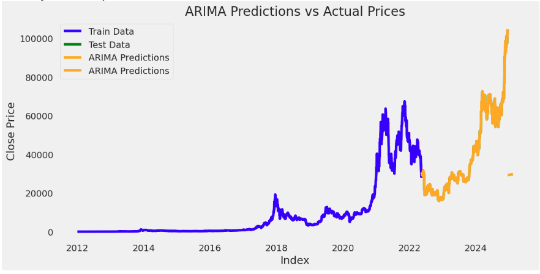
ARIMA - Metrics
ARIMA Model Evaluation Metrics:
Root Mean Squared Error (RMSE): 18,630.65
Mean Absolute Error (MAE): 15297.98
Mean Squared Error (MSE): 347,173,971.42
R-squared (R2): 0.72

Slide 11
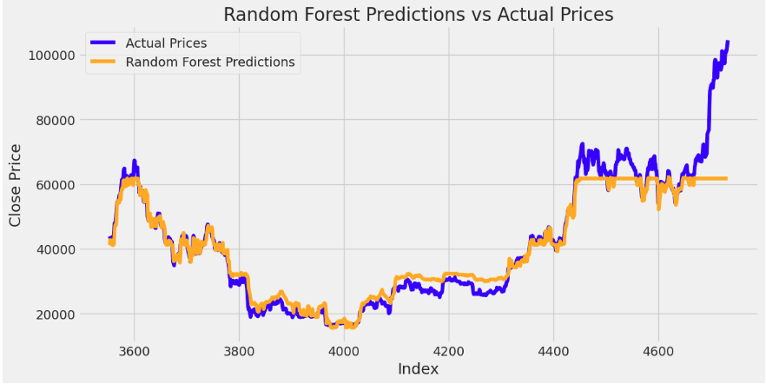
RANDOM FOREST - Metrics
Random Forest Evaluation Metrics:
Root Mean Squared Error (RMSE): 6116.64
Mean Absolute Error (MAE): 3295.77
Mean Squared Error (MSE): 37,444,453.09
R-squared (R2): 0.85

Slide 12
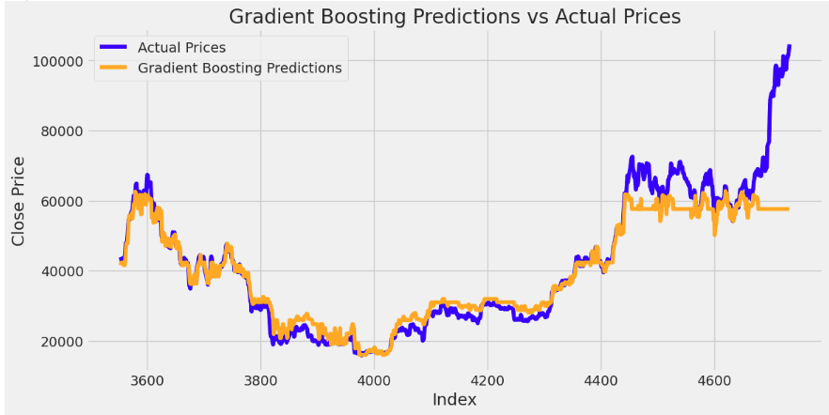
GRADIENT BOOSTING - Metrics
Gradient Boosting Evaluation Metrics:
Root Mean Squared Error (RMSE): 7234.95
Mean Absolute Error (MAE): 3896.71
Mean Squared Error (MSE): 52,355,774.68
R-squared (R2): 0.81

Slide 13
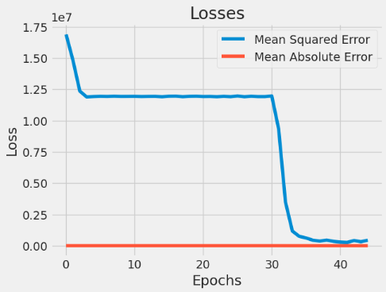
LSTM - Metrics
LSTM Evaluation Metrics:
Root Mean Squared Error (RMSE): 1101674407.65
Mean Absolute Error (MAE): 1101674407.44
Mean Squared Error (MSE): 1.2136865004652488e+18
R-squared (R2): -2665919967.17

Slide 14
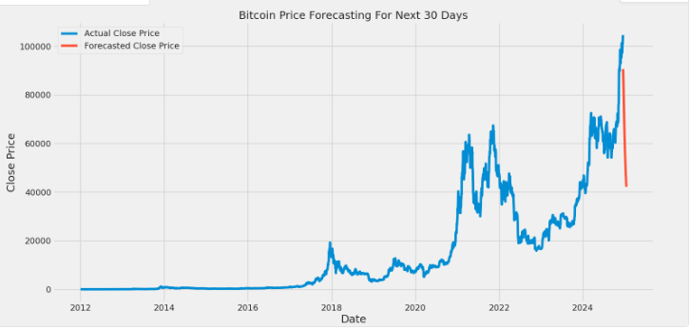
LSTM Model Tuning
LSTM Evaluation Metrics:
Root Mean Squared Error (RMSE): 3787.76
Mean Absolute Error (MAE): 2617.98
Mean Squared Error (MSE): 14347100.75
R-squared (R2): 0.96

Slide 15
Model Performance Comparison
Evaluation Metrics:
Mean Squared Error (MSE): Measures the average squared difference between actual and predicted prices.
Root Mean Squared Error (RMSE): Provides the error in the same units as the target variable.
Mean Absolute Error (MAE): Measures the average magnitude of prediction errors.
R-squared (R²): Represents the proportion of variance explained by the model.
Model | MSE | RMSE | R-Squared
ARIMA | 347,173,971.42 | 18,630.65 | 0.72
Random Forest | 37,444,453.09 | 6116.64 | 0.85
Gradient Boosting | 52,355,774.68 | 7234.95 | 0.81
LSTM | 14,347,100.00 | 3787.76 | 0.96

Slide 16
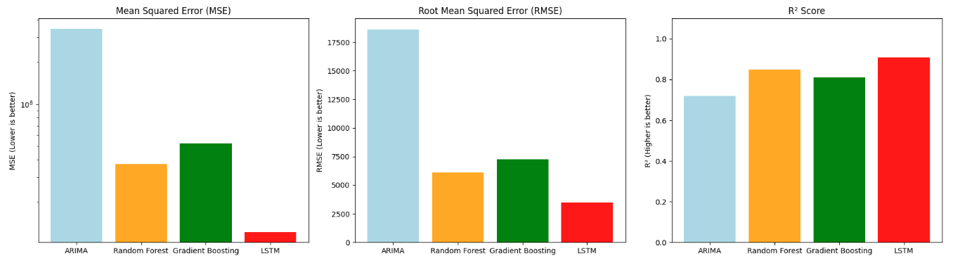
Model Performance Visualization

Slide 17
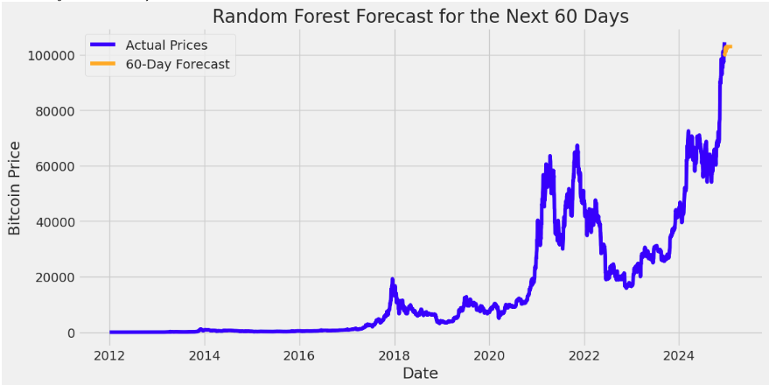
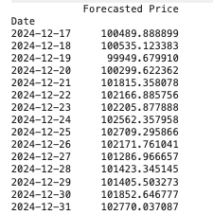
Random Forest Forecasting
Sample Forecast Prices

Slide 18
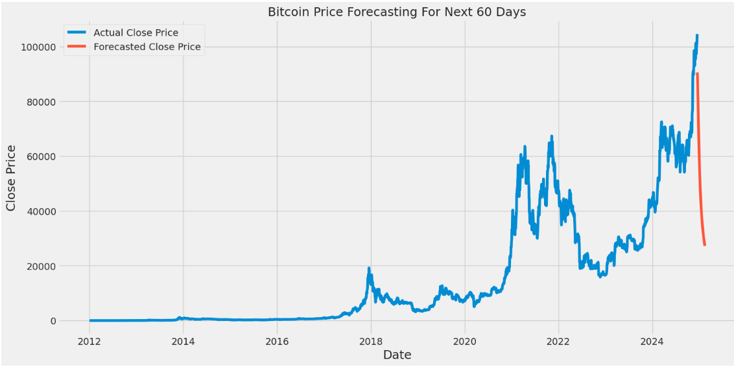
LSTM Forecasting

Slide 19
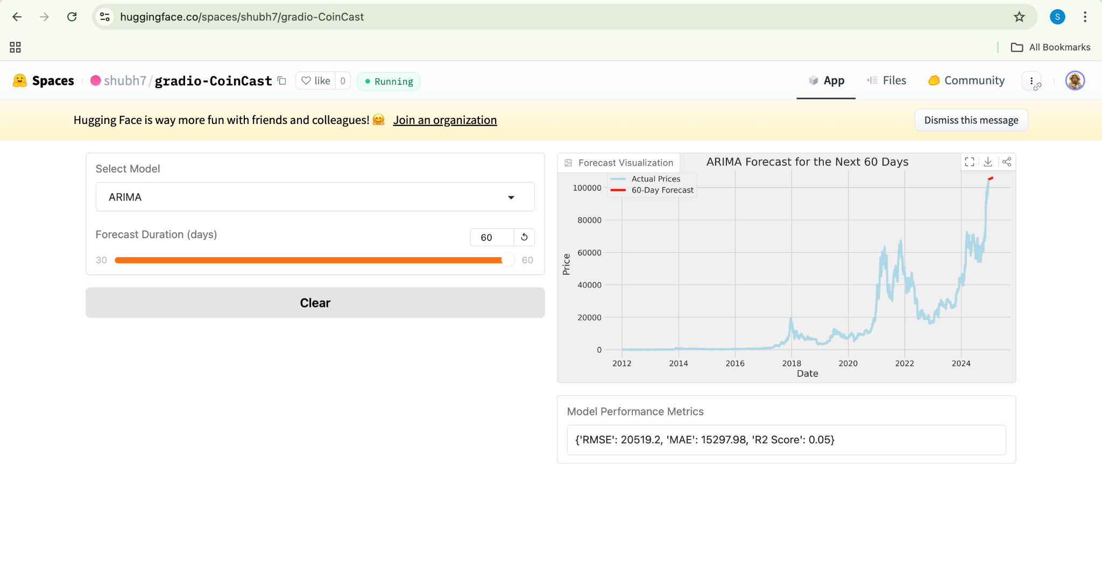
User Interface
UI Components:
Gradio Based Interactive User Interface.
Option to select the model (Eg: ARIMA, Random Forest, XGBoost, LSTM)
Bar to select the duration of desired forecast window (Eg:30)
Model’s Forecast Visualization and Metrics display.
Deployed in Hugging Face.

Slide 20

Deployment
Deployment Pipeline
The deployment pipeline is implemented using Hugging Face space for production-ready hosting, automated via GitHub Actions.
1. The trained model is saved in the required format (Pickle SavedModel).
2. GitHub Actions Pipeline automates the deployment process by pushing updates to the Hugging Face repository.
3. The Gradio-based application is hosted on Hugging Face Spaces for public access.
SCAN ME

Slide 21
Future Work
Hybrid Models: Combine LSTM with traditional models (e.g., ARIMA-LSTM or SARIMA-LSTM) to leverage the strengths of both methods. Develop ensemble models such as stacking LSTM, XGBoost and Prophet to compare and aggregate their predictions for improved accuracy.
Forecasting for Longer Horizons: Extend the forecast horizon beyond 60 days to evaluate how well the model generalizes over longer periods.Implement multi-step and probabilistic forecasting methods to quantify uncertainty in longer-term predictions.
Real-Time Forecasting on Dynamic Streaming Data: Currently the model is deployed in Hugging Face, but further enhancement can be incorporated by extending the project to incorporate real-time data streams using tools like Apache Kafka or Spark Streaming to forecast prices dynamically. Deploy the model as a live application, continuously ingesting Bitcoin price data and updating predictions in real time.

Slide 22

Conclusion
Evaluated multiple machine learning models, including ARIMA, Random Forest, XGBoost and others, with LSTM identified as the top performer.
Despite the success of the initial LSTM model, opted to implement model tuning techniques to further optimize its performance. By adjusting hyperparameters, the model demonstrated improved accuracy and enhanced the model’s ability to capture complex temporal patterns in Bitcoin price movements.
Forecasted the Bitcoin prices for the Upcoming 60 days using Random Forest and LSTM.
Designed and implemented an Interactive UI.
Deployed the models and the gradio based user interface in Hugging Face.

Slide 23

THANK YOU!
Team
Synergy

